Slide 1


2023 – 2024 Spring
EEEN 102 - Embedded Systems Programming
Final Project Presentation (30.05.2024)
First phase of open source complete Electronic Flight Instrument System (EFIS) set for UAVs, RC airplanes or backup for general aviation aircrafts.
Air Data Unit (v1.1)
Air Data Unit MCU Software (v0.1)
EFIS Display Software (v0.1.1) Developer: İbrahim Ç. Y.
For more and further updates,
visit project’s GitHub page:

Slide 2
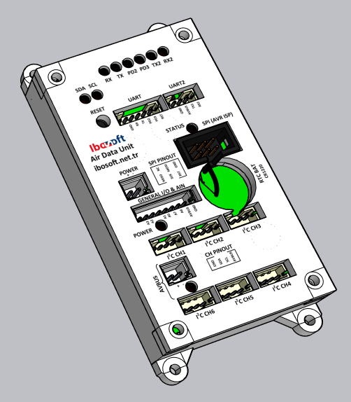
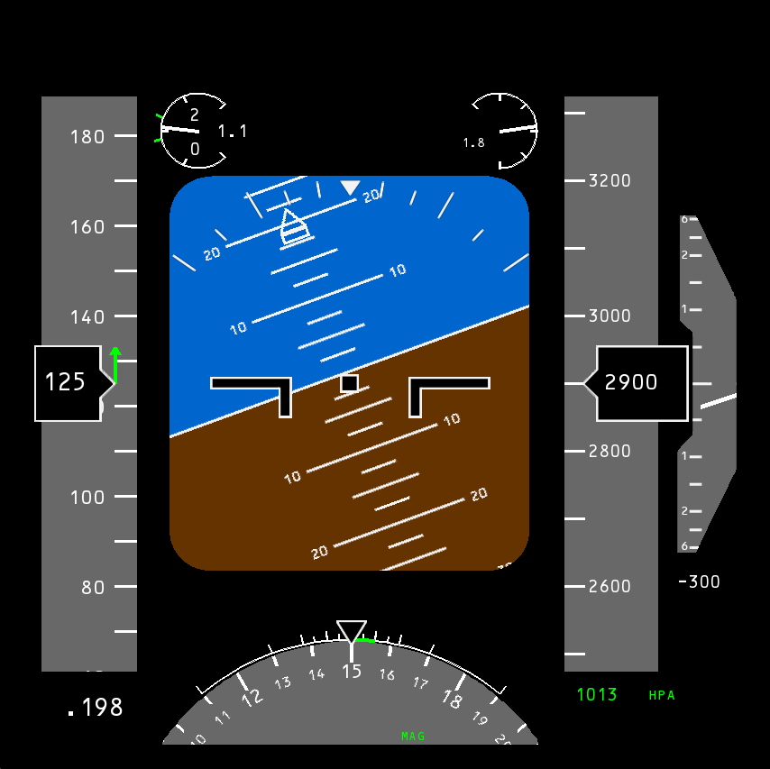
Main Features of EFIS System:
Air Data Unit Electrical Features:
Supply voltage range: 7.5 – 25 V.
High voltage protection by varistors.
Low voltage protection by MCU brownout detection.
Separated supply lines for board and external devices.
Max 100 mA for main board and max 500 mA for external outputs.
100 mA PTC fuses on each power out.
All I/O pins (except SPI) has serial current limiting resistors.
ATMega 328P MCU @ 20 MHz
RTC chip for date and time keeping.
CR1220 battery for RTC chip.
Separated I²C lines via switch for isolating lines from each other when corruption occurs on some of lines.
Main UART for data transmission and secondary UART for GNSS module.
UART1 can capable up to 230400 bauds and has flow control pins.
UART2 can capable up to 38400 bauds.
SPI port (6 pins AVR ISP).
6 configurable general purpose I/O or analog inputs.
Air Data Unit Software Limitations:
Max 36000 ft press. alt. @ ISA conditions.
Max 1.0 Mach.
Used Programming Languages in This Project:
C/C++ used for Air Data Unit’s MCU software.
Python used for EFIS Display Software.

Slide 3
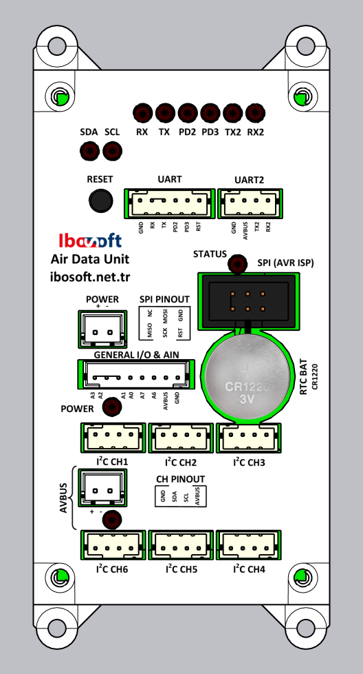
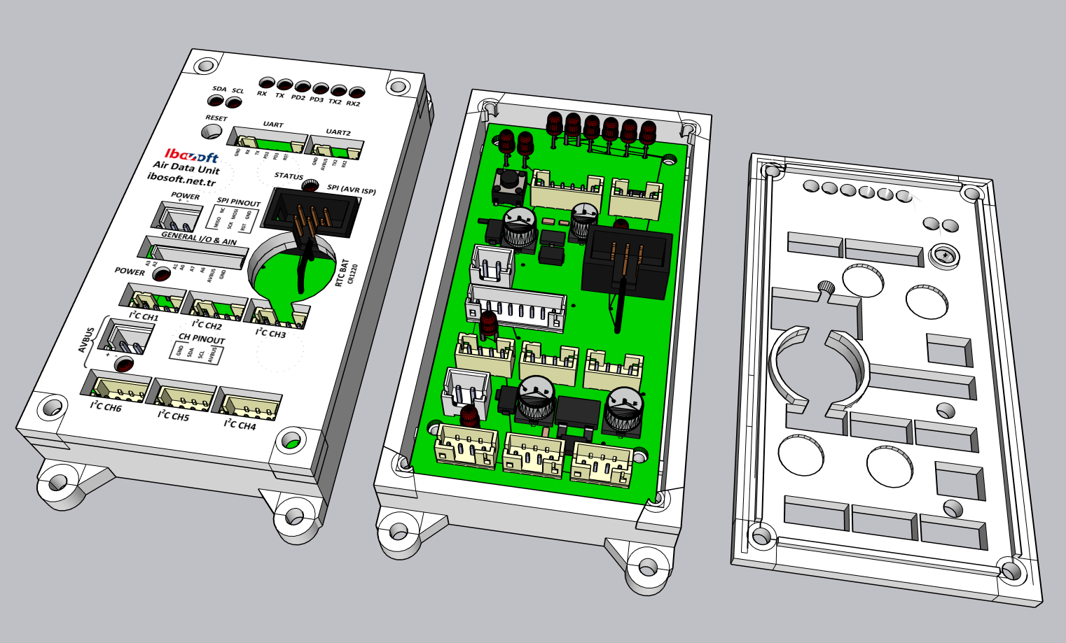
Air Data Unit Box:
M3 Screw Holes
10.5 cm
9.0 cm
Data Comm. LEDs
UART 2 Includes:
Serial I/O
Reset Button
UART 1 Includes:
Serial I/O
Two I/O reserved for flow control etc.
Reset Input.
Main Power In & On LED
Status LED
SPI (6 Pins AVR ISP)
For programming etc.
RTC Battery
CR1220
General I/O Pins Includes:
6× Pins can configure as digital I/O or analog input.
1× Power output.
6× I²C Channels
Avionics Bus Power In & On LED
For external outputs
5.0 cm

Slide 4
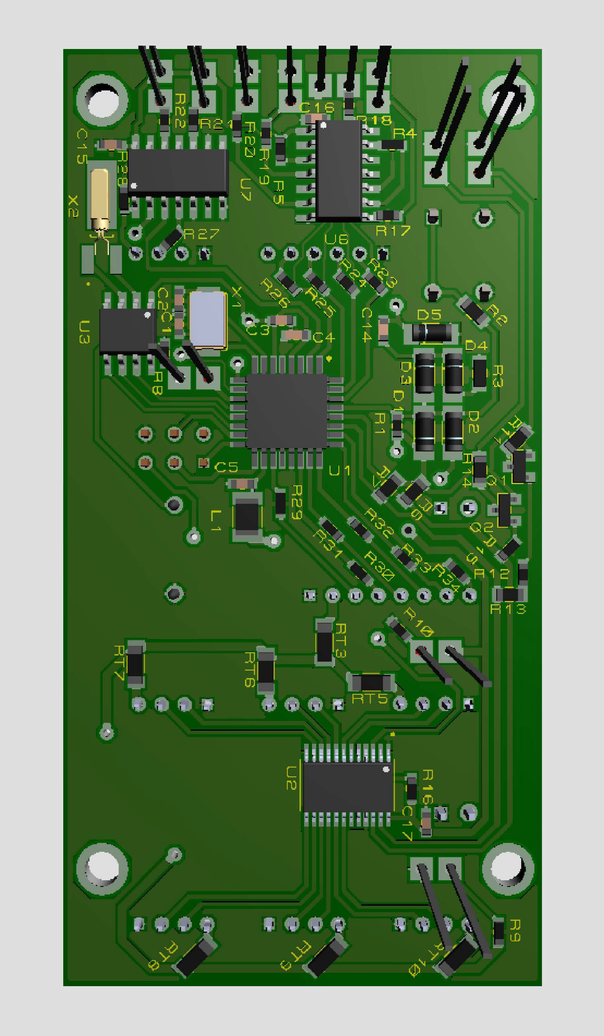

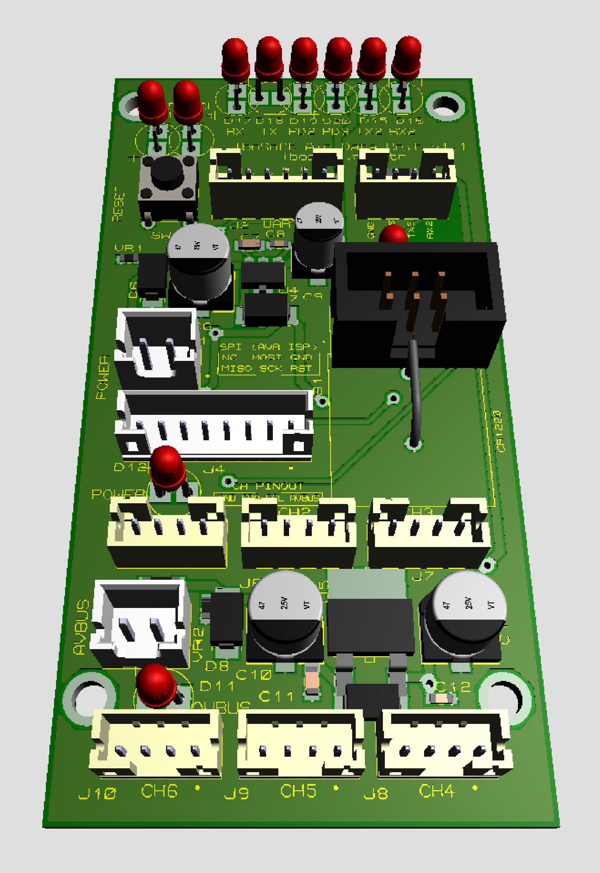



Electronic Circuit Board of Air Data Unit:
Block Diagram of Circuit:
Front View of Board:
Back View of Board:
UART 1
UART 2
Serial
Serial & Flow Control
Reset Signal
Status
Real Time Clock (RTC)
ATMega 328P Microcontroller @ 20 MHz
MCU
I²C Switch
Supply of
Main Board
Pulse Circuit
Reset Line
I²C Bus
RTC
SPI Bus
SPI
Supply of External Outputs
General I/O
I²C Switch
8.2 cm
CH 1
CH 2
CH 3
CH 4
CH 5
CH 6
4.2 cm

Slide 5

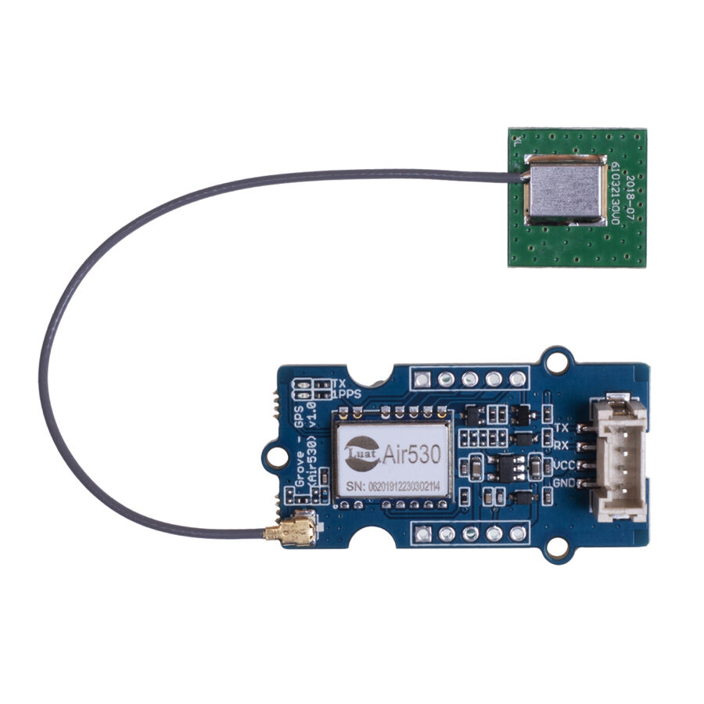
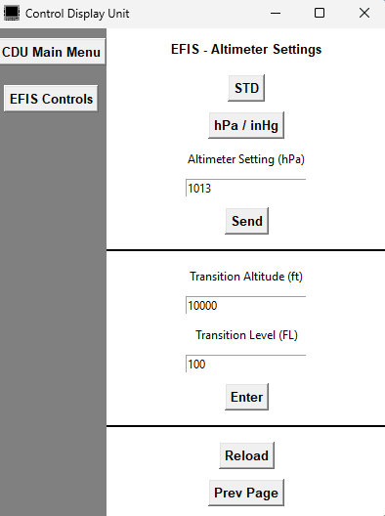

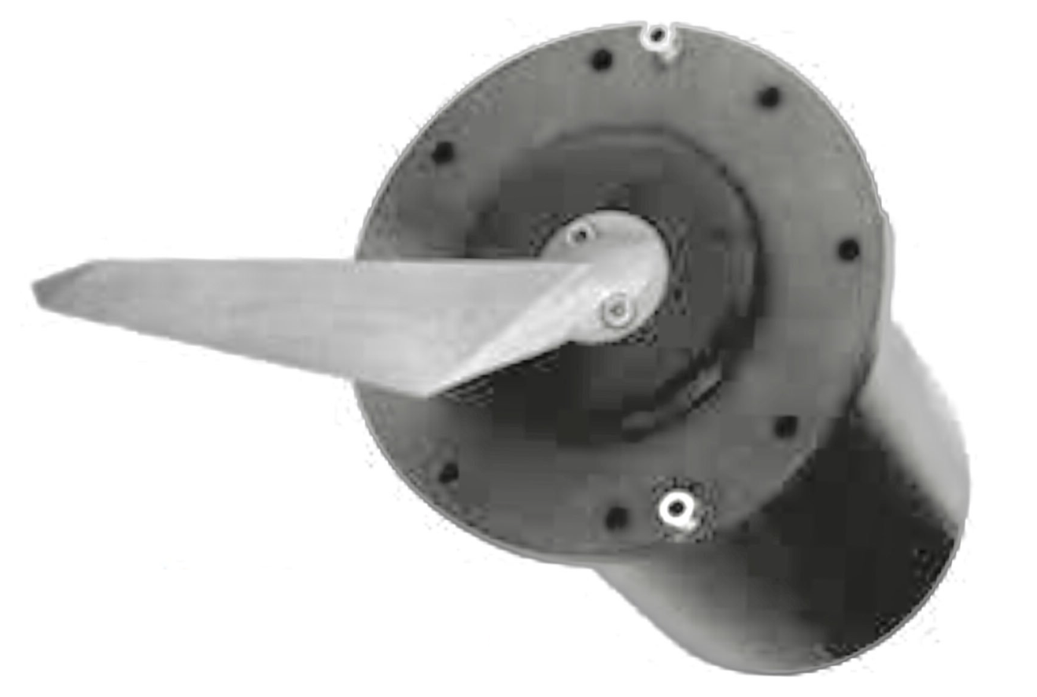
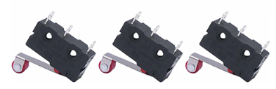
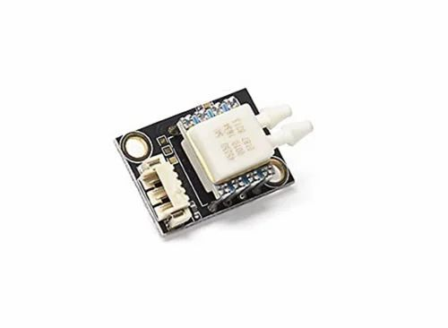
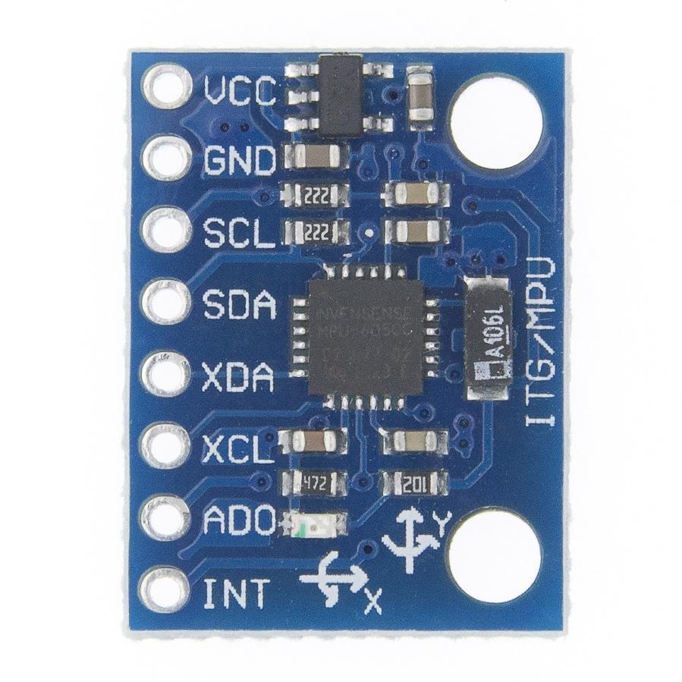
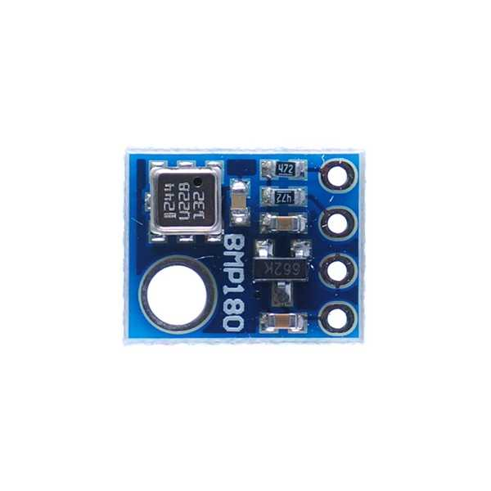
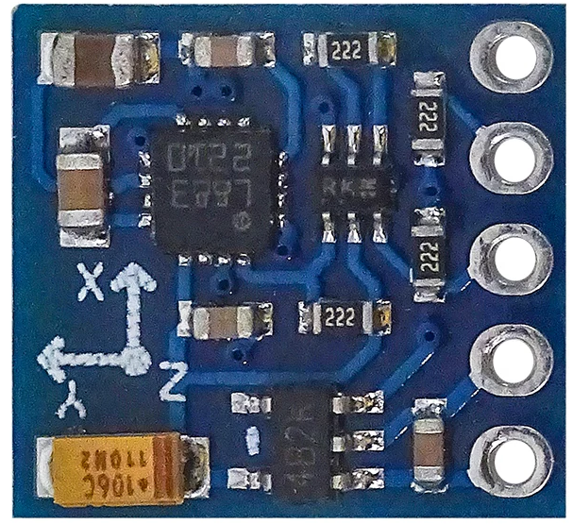
Connection Diagram of Sensors and Communication Lines:
Wired or Wireless Comm.
Air530 GNSS Receiver Supports: GPS / Beidou / Glonass / Galileo / QZSS, SBAS
To other avionic systems.
Angle of Attack Vane
Temp. Probe
Air / Ground Sense Switches
Supply for Main Board
Pitot – Static Tube
MS4525 Differential Pressure Sensor (Max 220 KIAS)
MPU6050 6-DOF Accelerometer & Gyroscope (Operated at ±8g & ±500 °/s)
BMP180 Pressure Sensor (Max -1500 - +29500 ft press alt.)
Static Pressure Line
Dynamic Pressure Line
QMC5883 3-DOF Magnetometer
Supply for External Devices

Slide 6
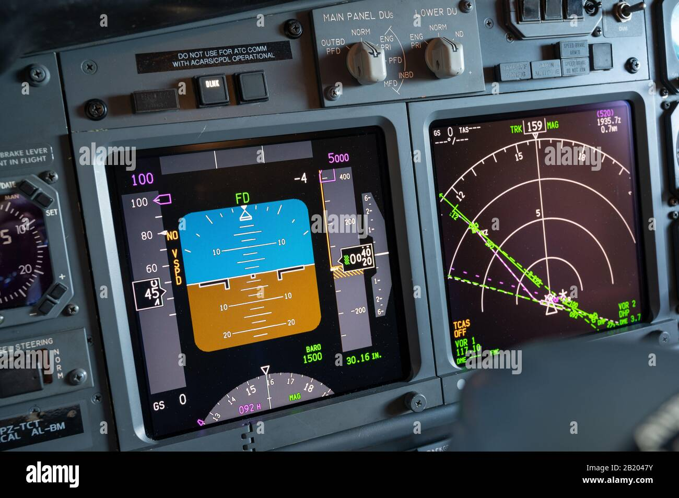
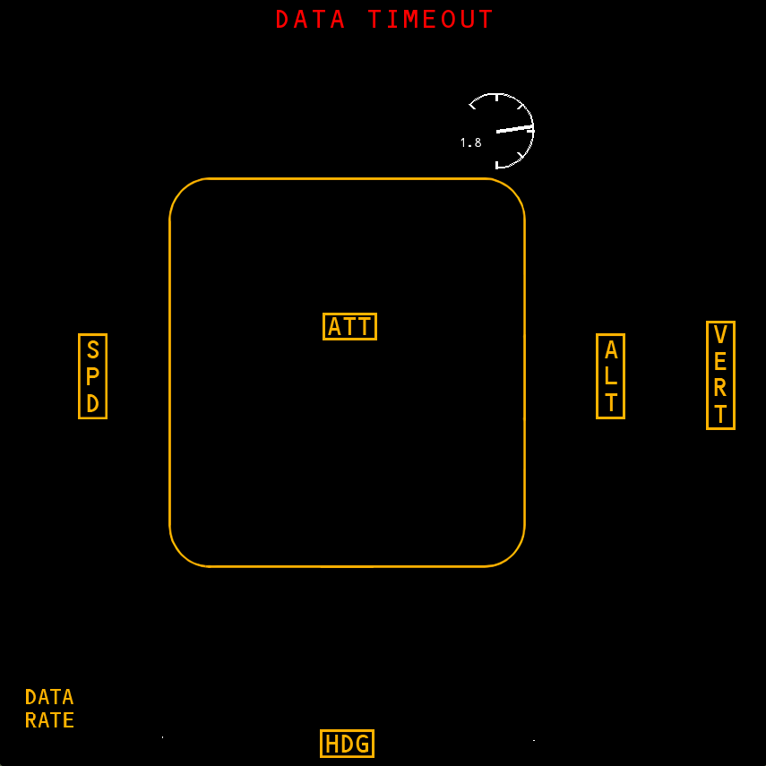
EFIS Display Software – Primary Flight Display (PFD):
P-8 Style
Vert. G Ind. (g)
Slip / Skid
Indicator
Angle of Attack Indicator (°)
G Peaks (g)
Altitude Tape
Airspeed Tape
Attitude Indicator
Boeing-style symbology was used due to familiarity.
PFD Display Used in B737 Airliners:
Altitude Indicator (ft)
Failure Flags:
Vertical Speed Indications (fpm)
Indicated Airspeed Indicator (knot)
Speed Trend
Arrow
Mach Number
Compass Mode Annunciation
Turn Rate Indication (°/s)
Altimeter Setting Indications
Compass (°)

Slide 7
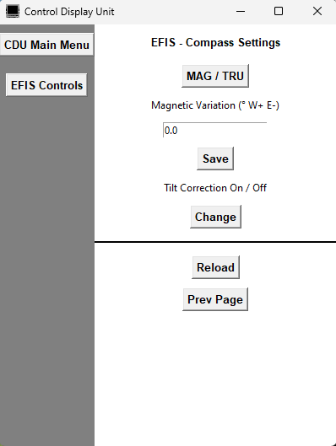
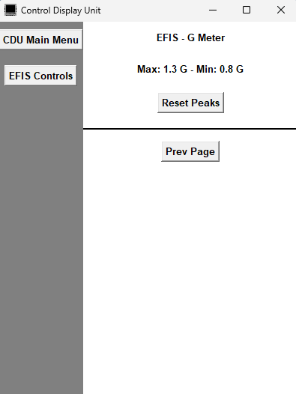
EFIS Display Software – Control Menu:
Altimeter Settings Sub-menu:
Compass Settings Sub-menu:
G Meter Sub-menu:

Slide 8
Thank You for Listening…
For more and further updates, visit project’s GitHub page:
github.com/ibosoftnet/efis/

